Slide 1
Power management overview
2021/09/03

Slide 2
Outline
Power management overview
Power management (HW)
  Ax45 power domain
  Ax45 SMU registers
Power management (SW)
  OpenSBI SMU Driver
    Light sleep implementation
    Deep sleep implementation
    CPU hotplug implementation
  Power management interface
  Linux Power management framework
  User space power management command

Slide 3
Outline
Power management overview
Power management (HW)
  Ax45 power domain
  Ax45 SMU registers
Power management (SW)
  OpenSBI SMU Driver
    Light sleep implementation
    Deep sleep implementation
    CPU hotplug implementation
  Power management interface
  Linux Power management framework
  User space power management command

Slide 4

Why Power Management?
Why need power management?
  Power/energy saving
  temperature control
application:
  Screen lock
  Hibernate
  CPU frequency reduce

Slide 5
Power Management Overview
Power management:
  SW (Linux)
    U-mode:
      Linux sysfs command
    S-mode:
      Linux Power management framework
    M-mode:
      architecture depend power management framework
        OpenSBI(RISC-V), PSCI(ARM), ACPI(X86)
  HW
    PMIC (power manage IC)
      SMU (system management unit)
      PMU (power management unit)
sysfs
PM
HSM
sw
hw
SMU
Peripheral device
cpu
mem
bus

Slide 6
Outline
Power management overview
Power management (HW)
  Ax45 power domain
  Ax45 SMU registers
Power management (SW)
  OpenSBI SMU Driver
    Light sleep implementation
    Deep sleep implementation
    CPU hotplug implementation
  Power management interface
  Linux Power management framework
  User space power management command

Slide 7
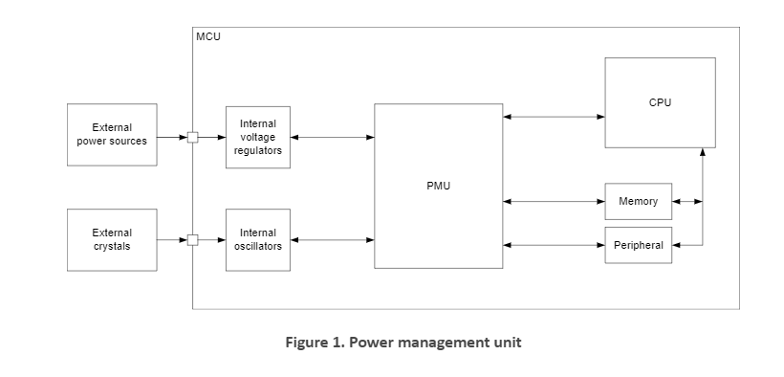
Power management IC
PMIC (power management IC)
  SMU (system management unit)
  PMU (power management unit)

Slide 8
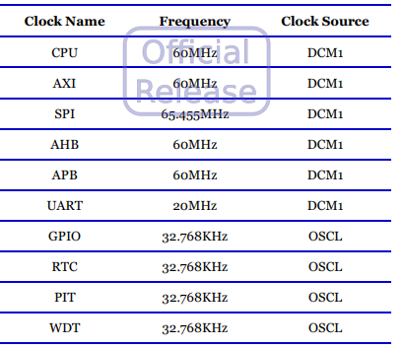
Power management IC
PMIC (power manage IC)
  SMU (system management unit)
    Clock setting
    PMU (power management unit)
      Provide different voltage to different devices
        Cpu, camera, usb …..
      Core reset
      Clock frequency adjustment.

Slide 9
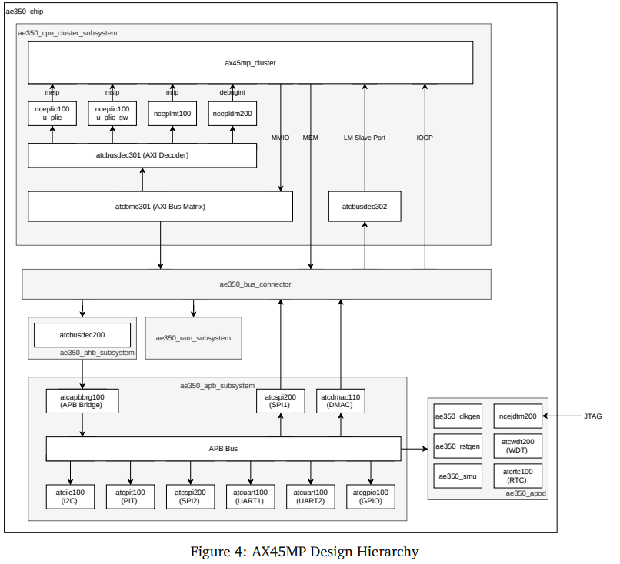
Ax45 SMU Block diagram

Slide 10
Ax45 SMU Block diagram
CPU region
HW
  CPU region
    CPU
    L1
    L2

Slide 11
Ax45 SMU Block diagram
CPU region
HW
  CPU region
    CPU
    L1
    L2
  Debug region
    Debug module
Debug region

Slide 12
Ax45 SMU Block diagram
CPU region
HW
  CPU region
    CPU
    L1
    L2
  Debug region
    Debug module
  Mem & device & bus region
    Memory subsystem
    AXI/AHB/APB Bus
    Peripheral devices
Debug region
mem & device & bus region

Slide 13
Ax45 SMU Block diagram
CPU region
HW
  CPU region
    CPU
    L1
    L2
  Debug region
    Debug module
  Mem & device & bus region
    Memory subsystem
    AXI/AHB/APB Bus
    Peripheral devices
  Always on region (AOPD)
    RTC
    WDT
Debug region
Always on region
mem & device & bus region
Always on region

Slide 14
Ax45 SMU Block diagram
CPU region
HW
  CPU region
    CPU
    L1
    L2
  Debug region
    Debug module
  Mem & device & bus region
    Memory subsystem
    AXI/AHB/APB Bus
    Peripheral devices
  Always on region (AOPD)
    SMU
    RTC
    WDT
Debug region
Always on region
mem & device & bus region
Always on region
SMU

Slide 15
Outline
Power management overview
Power management (HW)
  Ax45 power domain
  Ax45 SMU registers
Power management (SW)
  OpenSBI SMU Driver
    Light sleep implementation
    Deep sleep implementation
    CPU hotplug implementation
  Power management interface
  Linux Power management framework
  User space power management command

Slide 16
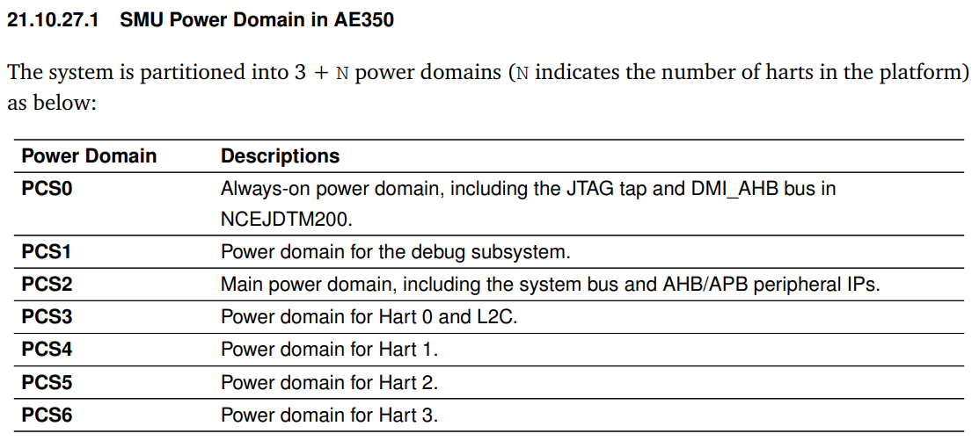
Ax45 power domain
7 power domains
  PCS (power control slot)
  PCS0~6

Slide 17
pcs0
Always on region
only AOPD remained
Always on region
SMU

Slide 18
pcs1
Debug region
Always on region
Always on region
AOPD + debug remained
SMU

Slide 19
pcs2
Debug region
Always on region
mem & device & bus region
Always on region
AOPD +
debug +
Mem
remained
SMU

Slide 20
Pcs3~6
CPU region
AOPD +
debug +
Mem +
cpu
remained
Debug region
Always on region
mem & device & bus region
Always on region
SMU

Slide 21
Ax45 SMU power down sequence
AE350 SMU (Hardware)
  Disable core_clk, lm_clk, dcu_clk
  Activate power clamps (電壓保護)
  Remove power
  Assert core_reset_n
CPU region
Set smu register
  PCS_CTL
  PCS_WE
  Reset_vector

Slide 22
Ax45 SMU power up sequence
AE350 SMU (Hardware)
  Assert core_reset_n
  Enable core_clk, lm_clk, dcu_clk
  Apply Power (UPF Simulation)
  Disable power clamps (UPF simulation)
  De-assert core_reset_n
CPU region
2. SMU wakeup other devices
1. Device send irq to SMU

Slide 23
Outline
Power management overview
Power management (HW)
  Ax45 power domain
  Ax45 SMU registers
Power management (SW)
  OpenSBI SMU Driver
    Light sleep implementation
    Deep sleep implementation
    CPU hotplug implementation
  Power management interface
  Linux Power management framework
  User space power management command

Slide 24
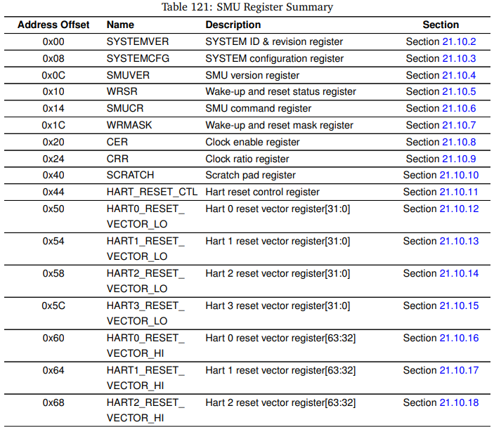
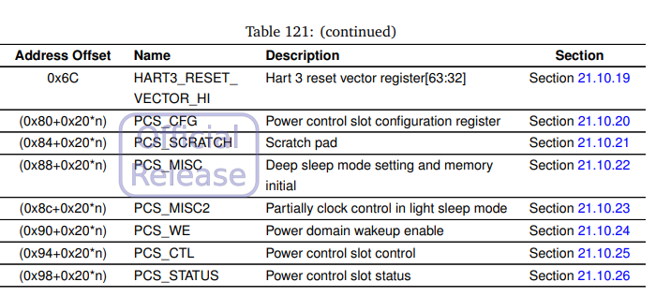
Ax45 SMU registers
MMIO registers
  AE350 BASE: 0xf0100000 (PA)
Important registers:
  0x50~0x6c: reset_vector
  0x84: PCS_SCRATCH
  0x90: PCS_WE
  0x94: PCS_CTL
  0x98: PCS_STATUS
ram
Smu mmio registers
systemver
Hart3_reset_vector_hi
Pcs1
pcs_cfg
Pcs1
pcs_status
Pcs2
pcs_cfg
…
…
…
0xf0100000
0xf0100080
0xf01000a0
SMU HW

Slide 25

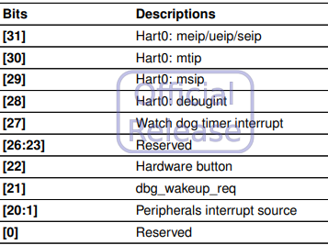
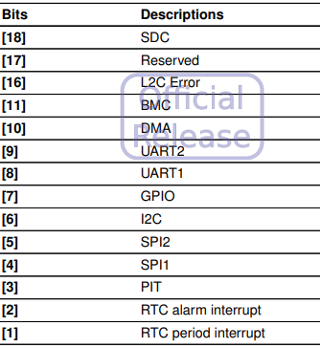
Ax45 SMU registers
Power Domain Wakeup Event Enable (PCS_WE) (0x90)
  Select wakeup sources

Slide 26
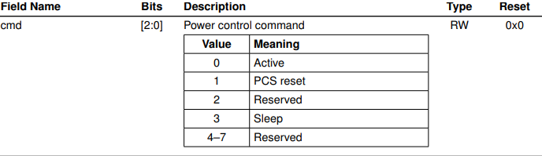
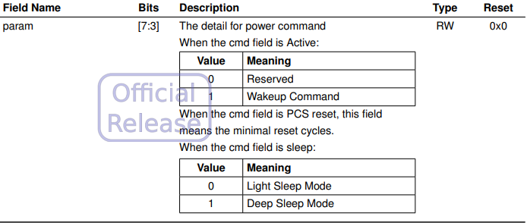
Ax45 SMU registers
Power Control Slot Control Register (PCS_CTL) (0x94)
  Control per core PCS:
    Enter Light sleep:
      0b00000011 = 0x3
    Enter deep sleep:
      0b00001011 = 0xb
    Wakeup:
      0b00001000 = 0x8
param
cmd
00000
000
PCS_CTL

Slide 27
Outline
Power management overview
Power management (HW)
  Ax45 power domain
  Ax45 SMU registers
Power management (SW)
  OpenSBI SMU Driver
    Light sleep implementation
    Deep sleep implementation
    CPU hotplug implementation
  Power management interface
  Linux Power management framework
  User space power management command

Slide 28
Terminology of power management
AE350 Power management status:
  Normal
  Suspend to idle (freeze)
    wfi()
  Suspend to idle (light sleep) (half PCS3)
    Disabled Core clk
      Disable L1
    L2 still on
  Suspend to ram (deep sleep) (PCS3)
    Core power down
      Disable L1
      All Register reset
    Disabled L2
  Suspend to disk (Not support) (PCS2)
    Disabled Core clk
    Disabled L2
    Disable Memory

Slide 29
AE350 power up/down sequence
Power down sequence
  User
    echo 0 > /sys/devices/system/cpu/cpu[n]/online
    echo standby > /sys/power/state
    echo mem > /sys/power/state
  Core[n] (Software OpenSBI smu.c)
    Need to be implemented
  AE350 SMU (Hardware)
    Disable core_clk, lm_clk, dcu_clk
    Activate power clamps (UPF simulation)
    Remove power (UPF simulation)
    Assert core_reset_n
Power up sequence
  User
    echo 1 > /sys/devices/system/cpu/cpu[n]/online
    Rtc or uart wakeup
  Core[n] (Software OpenSBI smu.c)
    Need to be implemented
  AE350 SMU (Hardware)
    Assert core_reset_n
    Enable core_clk, lm_clk, dcu_clk
    Apply Power (UPF Simulation)
    Disable power clamps (UPF simulation)
    De-assert core_reset_n
sysfs
PM
HSM
sw
hw
SMU
Peripheral device
cpu
mem
bus

Slide 30
Outline
Power management overview
Power management (HW)
  Ax45 power domain
  Ax45 SMU registers
Power management (SW)
  OpenSBI SMU Driver
    Light sleep implementation
    Deep sleep implementation
    CPU hotplug implementation
  Power management interface
  Linux Power management framework
  User space power management command

Slide 31
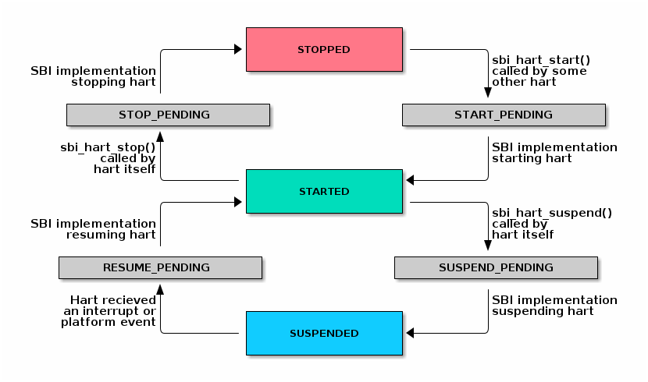
OpenSBI HSM
OpenSBI HSM (Hart State Management Extension)
Current Andes OpenSBI has not implemented suspend status.

Slide 32
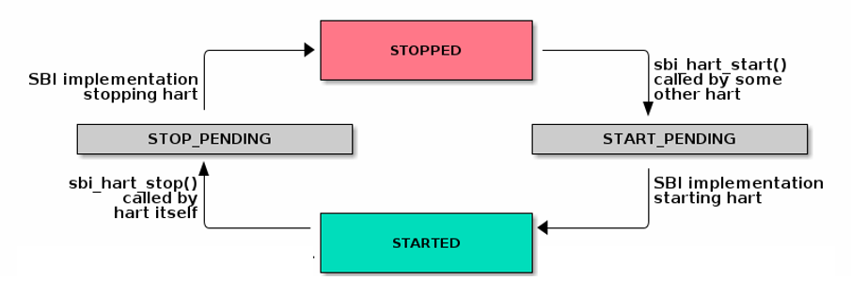
OpenSBI SMU Driver
OpenSBI HSM + SMU driver
OpenSBI SMU driver
Enter sleep mode:
  Deep sleep
  Light sleep
  Cpu hotplug with deep sleep
SMU hardware
Exit sleep mode:
  Deep sleep
  Light sleep
  Cpu hotplug with deep sleep
Trigger hart stop

Slide 33
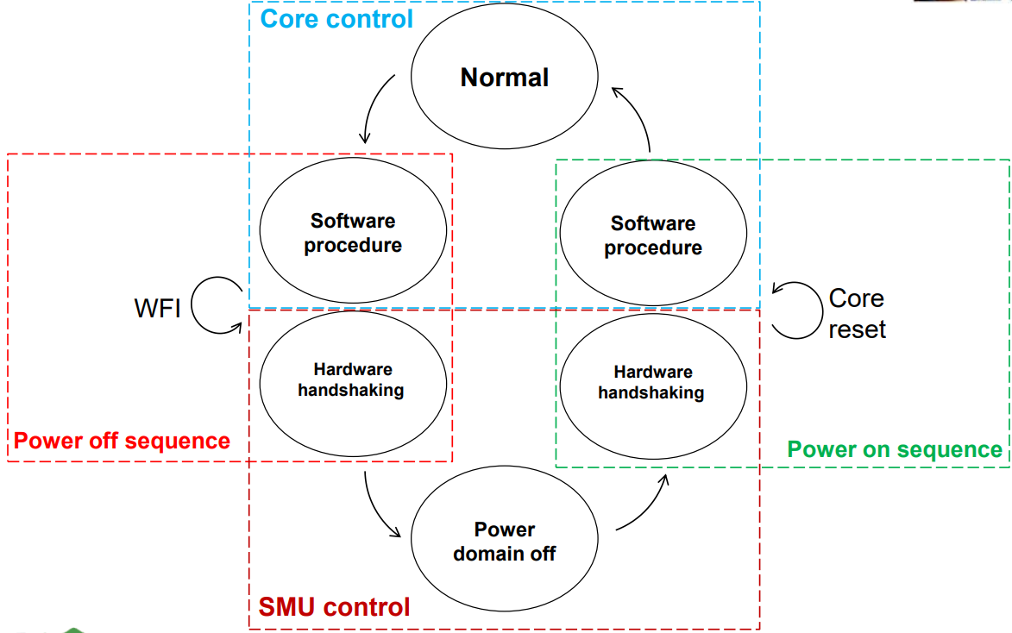
System overall flow for power management

Slide 34
Outline
Power management overview
Power management (HW)
  Ax45 power domain
  Ax45 SMU registers
Power management (SW)
  OpenSBI SMU Driver
    Light sleep implementation
    Deep sleep implementation
    CPU hotplug implementation
  Power management interface
  Linux Power management framework
  User space power management command

Slide 35
Light sleep Implementation
Light sleep power down
Kernel
OpenSBI SMU Driver
Main core
SMU
process
suspend
Set
PCS_WE
Disable
D$
Other cores
other core
Other hart
sleep
Other cores
Disable
MIE*
Check
PCS_STATUS
Write back
D$
WFI
other core
main core
Driver
suspend
Set 0x3
PCS_CTL
main core
Disable CM
other core
Wait for other cores ready
Enter sleep mode
Disable IRQ
Setup SMU
Disable Cache
PCS_WE:
  Main core: rtc or uart
  Other core: MSIP

Slide 36
Light sleep Implementation
Light sleep power up
Wakeup event
OpenSBI SMU Driver
Kernel
SMU
enable CM
Main core
Other
Cores
wakeup
Main
Core
wait
Enable
MIE*
Driver
resume
main core
process
resume
enable
D$
Other cores
Wait for
other cores
ready
Enable Cache
Enable IRQ
other core
other core
other core
Send MSIP to wake other cores up

Slide 37
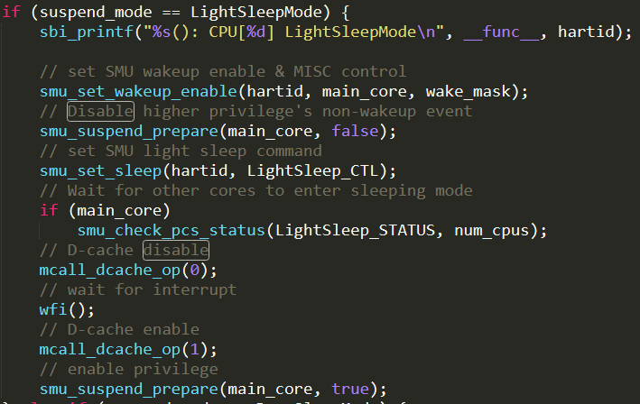
Light sleep Implementation
Light sleep:
  Wakeup PC is the next instruction after wfi
sleep here
wakeup here

Slide 38
Outline
Power management overview
Power management (HW)
  Ax45 power domain
  Ax45 SMU registers
Power management (SW)
  OpenSBI SMU Driver
    Light sleep implementation
    Deep sleep implementation
    CPU hotplug implementation
  Power management interface
  Linux Power management framework
  User space power management command

Slide 39
Deep sleep Implementation
deep sleep power down
Kernel
OpenSBI SMU Driver
Main core
SMU
process
suspend
Set
Reset_vec
Store
Registers
Disable D$
other core
Write back D$
Other hart
sleep
Disable
MIE*
Set
PCS_WE
Check
PCS_STATUS
WFI
Other cores
Disable CM
other core
main core
Store
sp address
to
PCS_SCRATCH
main core
Driver
suspend
Set 0xb
PCS_CTL
Disable L2
other core
Other cores
Check L2 status
Wait for other cores ready
Store regs
Disable
Cache
Enter sleep mode
Disable IRQ
Setup SMU
PCS_WE:
  Main core: rtc or uart
  Other core: MSIP
Deep sleep only

Slide 40
Deep sleep Implementation
Deep sleep:
  Backup CSR to sp
    X0~X31
    Floating CSR (Not implemented)
    Machine mode CSR
    Supervisor mode CSR
    Andes Custom CSR
    PMP CSR
  Save “sp” to PCS_SCRATCH
  Set reset vector
    Hart “PC” will be reset
    Need to set return PC in HART0_RESET_VECTOR_LO
  Disable D-cache & wb
    Write back L1 to L2
  Disable CM
  Disable L2 & wb
    Write back L2 to RAM
  WFI
L1
L1
x0
L1
…
x0
L1
…
x31
x31
…
…
mcache_ctl
mcache_ctl
…
…
satp
satp
…
…
sp
pmpaddr15
sp
pmpaddr15
x0
…
Deep Sleep
L1_cctl_wb
x31
…
L2
L2
mcache_ctl
…
x0
x0
…
…
satp
L2_cctl_wb
…
x31
x31
…
…
pmpaddr15
RAM
RAM
mcache_ctl
mcache_ctl
…
…
satp
satp
…
…
pmpaddr15
pmpaddr15
CORE1_
PCS_SCRATCH
HW SMU
CORE0_
PCS_SCRATCH
CORE1_
PCS_SCRATCH
HW SMU
CORE0_
PCS_SCRATCH
  L1 & L2 will be reset 0 after deep sleep

Slide 41
Deep sleep Implementation
Deep sleep:
  Enable CM
  Enable I/D Cache
  Enable L2
  restore “sp” from PCS_SCRATCH
  Restore CSR
    X0~X31
    Floating CSR (Not implemented)
    Machine mode CSR
    Supervisor mode CSR
    Andes Custom CSR
    PMP CSR
L1
L1
L1
x0
L1
…
x0
…
x31
x31
…
…
mcache_ctl
mcache_ctl
…
…
satp
satp
…
…
sp
pmpaddr15
sp
pmpaddr15
L2
wakeup
L2
x0
x0
…
…
x31
x31
…
…
RAM
RAM
mcache_ctl
mcache_ctl
…
…
satp
satp
…
…
pmpaddr15
pmpaddr15
CORE1_
PCS_SCRATCH
HW SMU
CORE0_
PCS_SCRATCH
CORE1_
PCS_SCRATCH
HW SMU
CORE0_
PCS_SCRATCH
  L1 & L2 do not have the data and will fetch the data from ram.

Slide 42
Deep sleep Implementation
Deep sleep power up
Wakeup event
OpenSBI SMU Driver
Kernel
SMU
enable
CM
Get “sp”
address
From
PCS_SCRATCH
Main core
Other
Cores
wakeup
Main
Core
wait
Enable
MIE*
Driver
resume
main core
process
resume
enable
D$/I$
restore
Registers
from ram
(sp address)
enable
L2
Other cores
Wait for
other cores
ready
Enable
Cache
Restore regs
Enable IRQ
other core
other core
Send MSIP to wake other cores up
other core
Deep sleep only

Slide 43
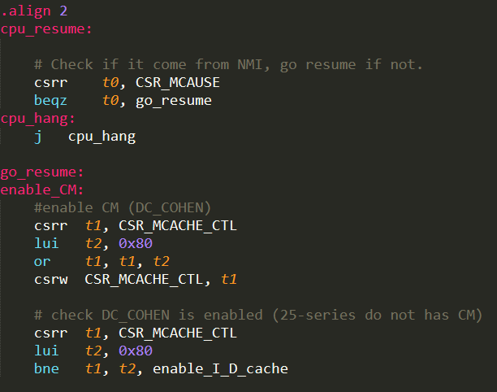
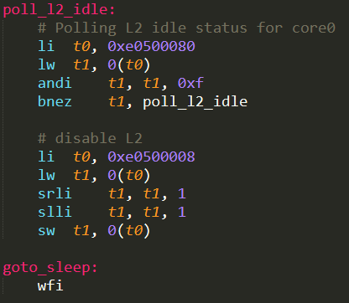
Deep sleep Implementation
Deep sleep:
  Wakeup PC is the not the next instruction after wfi, it will jump to HART0_RESET_VECTOR_LO.
    Set HART0_RESET_VECTOR_LO=cpu_resume()
    deep sleep (wfi)
    First instruction will be cpu_resume()
      Csrr t0, CSR_MCAUSE
wakeup here:
HART0_RESET_VECTOR_LO
sleep here

Slide 44
Outline
Power management overview
Power management (HW)
  Ax45 power domain
  Ax45 SMU registers
Power management (SW)
  OpenSBI SMU Driver
    Light sleep implementation
    Deep sleep implementation
    CPU hotplug implementation
  Power management interface
  Linux Power management framework
  User space power management command

Slide 45
CPU Hotplug Deep sleep Implementation
CPU hotplug deep sleep power down
Kernel
OpenSBI SMU Driver
SMU
process
suspend
Set
Reset_vec
Store
Registers
Disable D$
Main core
Write back D$
Other hart
sleep
Disable
MIE*
Set
PCS_WE
Check
PCS_STATUS
WFI
Disable CM
main core
Store
sp address
to
PCS_SCRATCH
Driver
suspend
Set 0xb
PCS_CTL
Disable L2
Check L2 status
Wait for other cores ready
Store regs
Disable
Cache
Enter sleep mode
Disable IRQ
Setup SMU
PCS_WE:
  core: 0
    Should not be waken up by any wakeup event
No need in CPU hotplug Deep sleep

Slide 46
CPU Hotplug Deep sleep Implementation
Deep sleep power up
Other core write
wakeup signal(0x8) to
HART[n]_PCS_CTL
OpenSBI SMU Driver
Kernel
SMU
enable
CM
Get “sp”
address
From
PCS_SCRATCH
core
Driver
resume
Other
Cores
wakeup
Main
Core
wait
process
resume
enable
D$/I$
Enable
MIE*
restore
Registers
from ram
(sp address)
enable
L2
Wait for
other cores
ready
Enable
Cache
Restore regs
Enable IRQ

Slide 47
Outline
Power management overview
Power management (HW)
  Ax45 power domain
  Ax45 SMU registers
Power management (SW)
  OpenSBI SMU Driver
    Light sleep implementation
    Deep sleep implementation
    CPU hotplug implementation
  Power management interface
  Linux Power management framework
  User space power management command

Slide 48
Power management interface
ACPI
  Intel x86
PSCI
  arm
OpenSBI
  RISC-V
sysfs
PM
PM
interface
sw
hw
SMU
Peripheral device
cpu
mem
bus

Slide 49
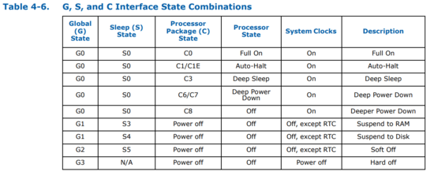
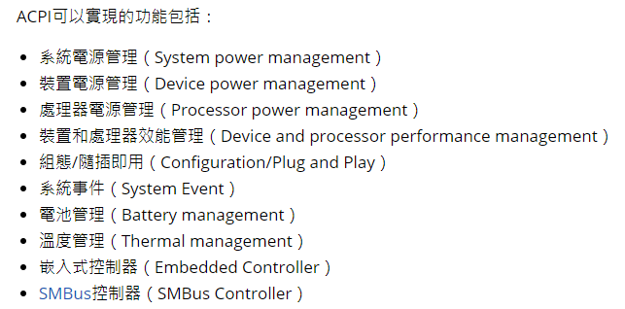
Power management interface
ACPI (Advanced Configuration and Power Interface)

Slide 50
Power management interface
ACPI (Advanced Configuration and Power Interface)

Slide 51
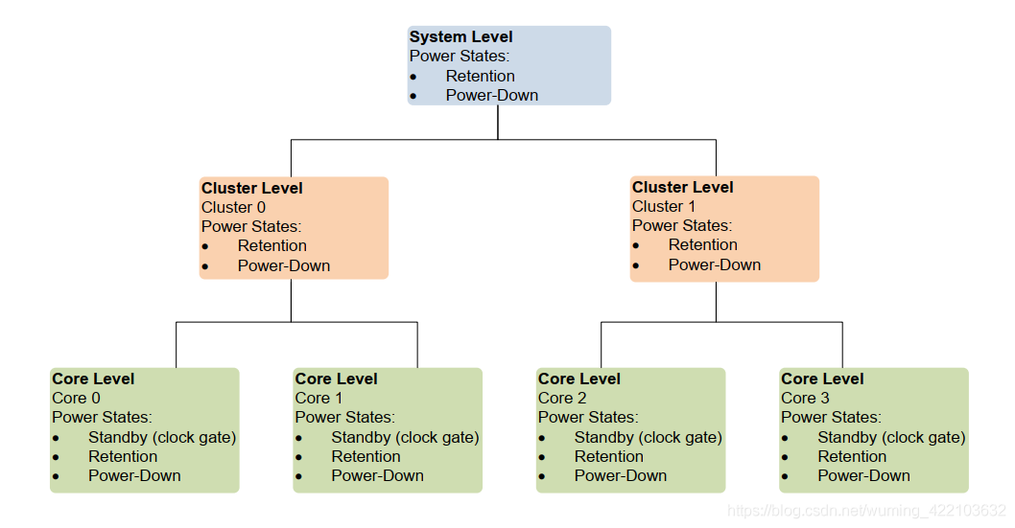
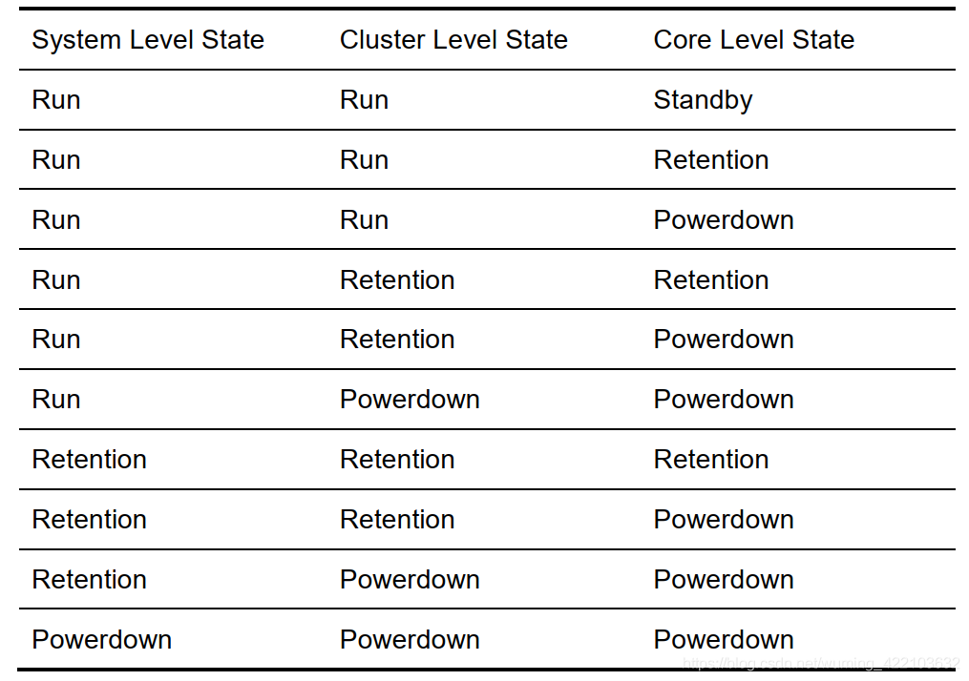
Power management interface
PSCI (The Power State Coordination Interface)

Slide 52
Outline
Power management overview
Power management (HW)
  Ax45 power domain
  Ax45 SMU registers
Power management (SW)
  OpenSBI SMU Driver
    Light sleep implementation
    Deep sleep implementation
    CPU hotplug implementation
  Power management interface
  Linux Power management framework
  User space power management command

Slide 53
Linux Power management framework
Linux power management framework
  Core status management
    Idle, cpu_up, cpu_die …
  CPU hotplug management
  System suspend/resume management
    Peripheral device suspend/resume
    Console suspend/resume
    Process suspend/resume
  CPU frequency management
sysfs
PM
PM
interface
sw
hw
SMU
Peripheral device
cpu
mem
bus

Slide 54
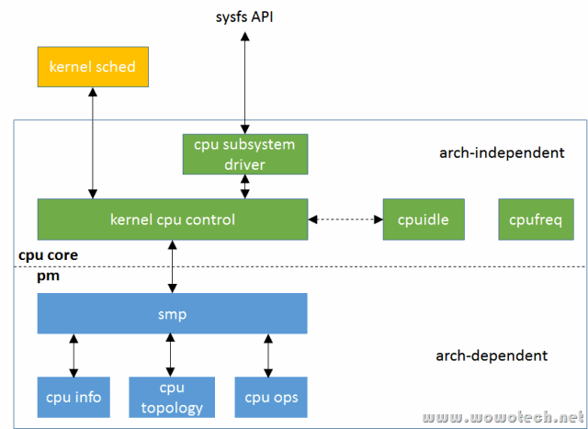
Linux Power management framework
Linux power management framework

Slide 55
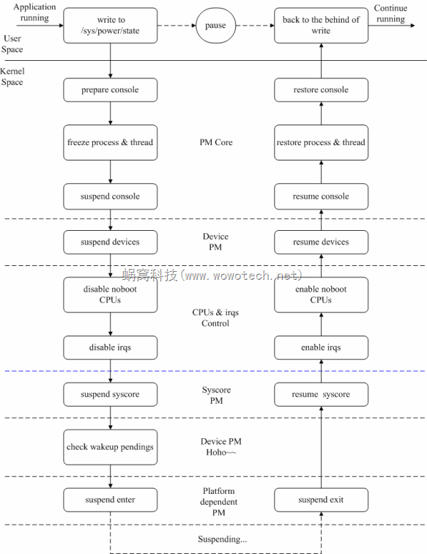
Linux Power management framework
Disable other CPUs:
Other cores jump to M-mode
Generic
pm driver
platform
pm driver
Main core:
Move these functions to OpenSBI SMU driver

Slide 56
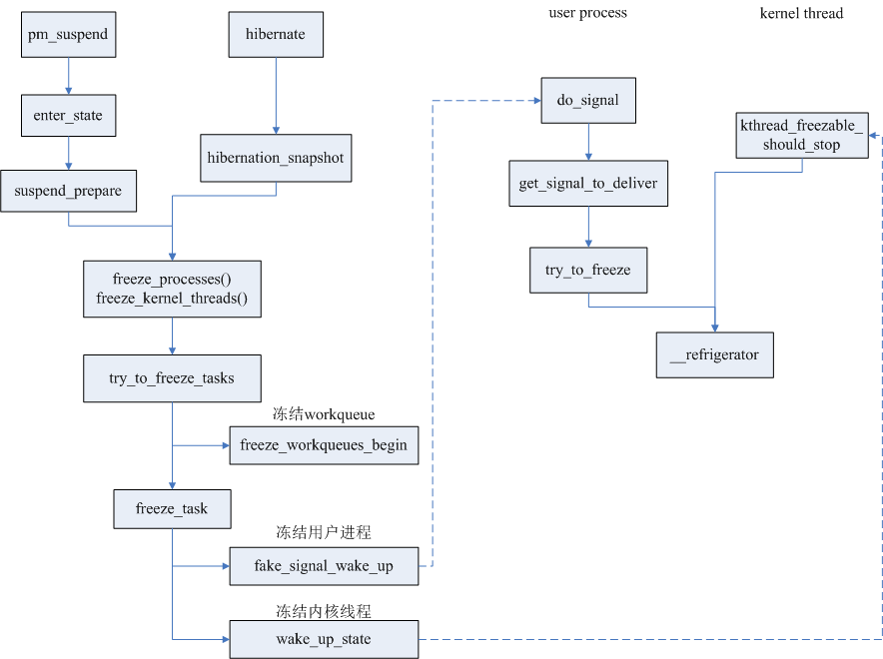
Linux Power management framework
freezing of tasks
  Freeze work_queue
    set max_active=0
  Freeze user process & kthread
Generic
pm driver
platform
pm driver

Slide 57
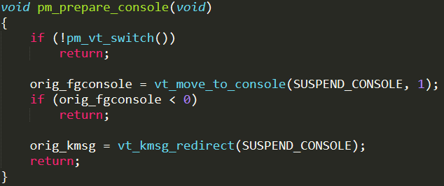
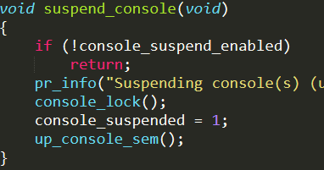
Linux Power management framework
Suspend console
  Redirect console to kmsg
  Lock console in kernel/printk.c
Resume console
  Unlock console in kernel/printk.c
  Redirect console to original console
Generic
pm driver
platform
pm driver

Slide 58
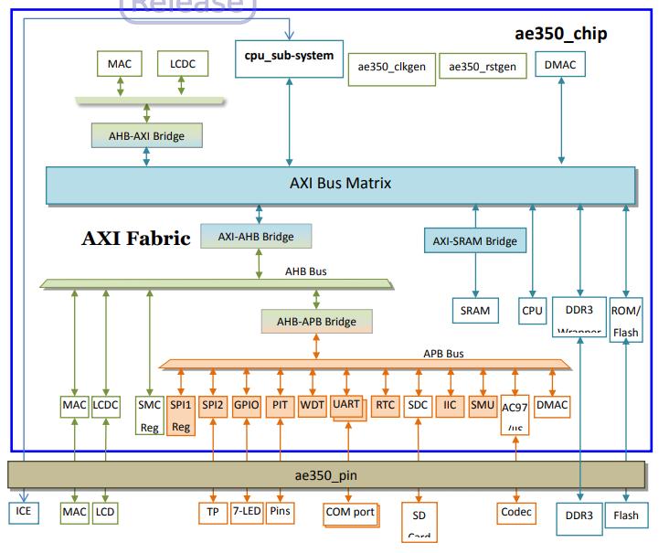
Linux Power management framework
Suspend/resume peripheral devices driver
  If not suspend peripherals may cause unexpected bus hang.
  Peripheral data loss ??
Generic
pm driver
Bus hanged occurs when MAC or LCD keep sending signal to bus after deep sleep.
Bus wants to connect with L2, but L2 is powered down.
platform
pm driver

Slide 59
Outline
Power management overview
Power management (HW)
  Ax45 power domain
  Ax45 SMU registers
Power management (SW)
  OpenSBI SMU Driver
    Light sleep implementation
    Deep sleep implementation
    CPU hotplug implementation
  Power management interface
  Linux Power management framework
  User space power management command

Slide 60
User space command
CPU Hotplug with deep sleep
  offline
    echo 0 > /sys/devices/system/cpu/cpu[X]/online
  online
    echo 1 > /sys/devices/system/cpu/cpu[X]/online
Deep/Light sleep
  Setup wakeup source
    echo enabled > /sys/devices/platform/soc/f0300000.serial/tty/ttyS0/power/wakeup
  Sleep
    Deep sleep:
      echo mem > /sys/power/state
    Light sleep:
      echo standby > /sys/power/state
  Wakeup
    Press any key on keyboard
sysfs
PM
PM
interface
sw
hw
SMU
Peripheral device
cpu
mem
bus

Slide 61
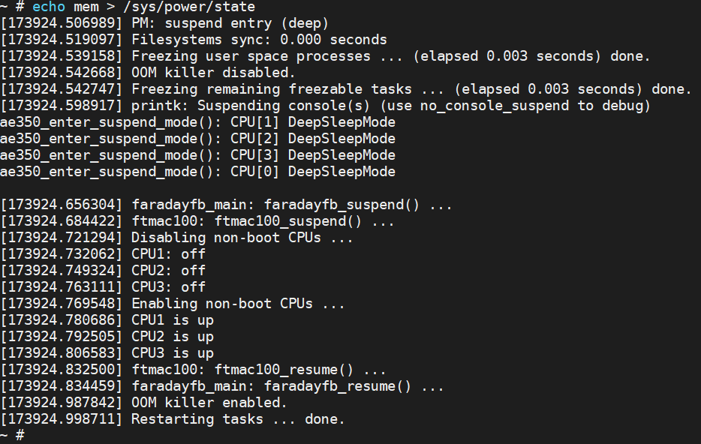
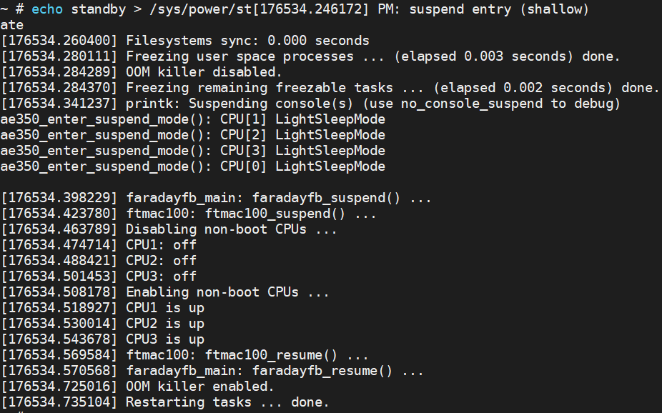
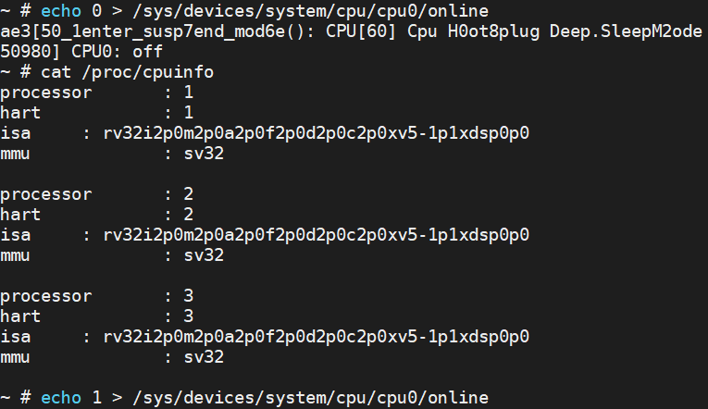
User space command
Deep sleep
light sleep
Cpu hotplug with deep sleep

